Slide 1

Presenting your event-study estimates

Slide 2
Three topics
1.) Presenting your equations within the body of your manuscript
2.) Making event-study figures
3.) A few miscellaneous items

Slide 3
Presenting your equations within the text
Three cases:
(i) You lead with TWFE estimates and then show results from one of the new estimators (e.g., Sun and Abraham 2021; Callaway and Sant’Anna 2021)
(ii) You lead with results from one of the new estimators
(iii) You show a TWFE equation, but only present estimates from one of the new estimators

Slide 4
Case (i): Lead with TWFE estimates and then show results from one of the new DD estimators
Common approach
From a writing perspective…
Pros:
Present a baseline equation that is straightforward to describe and reference
Takes up minimal space within the “Empirical Strategy” section of your paper
Present a baseline equation that everyone is familiar with
Anyone who runs regressions (i.e., not just economists) can follow along
Cons:
Risk turning off readers who only want to see results from one of the new DD estimators
Big problem when reader is a referee!

Slide 5
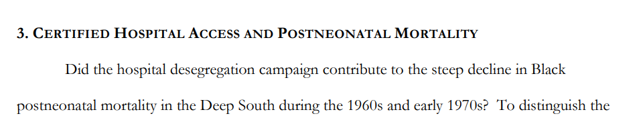
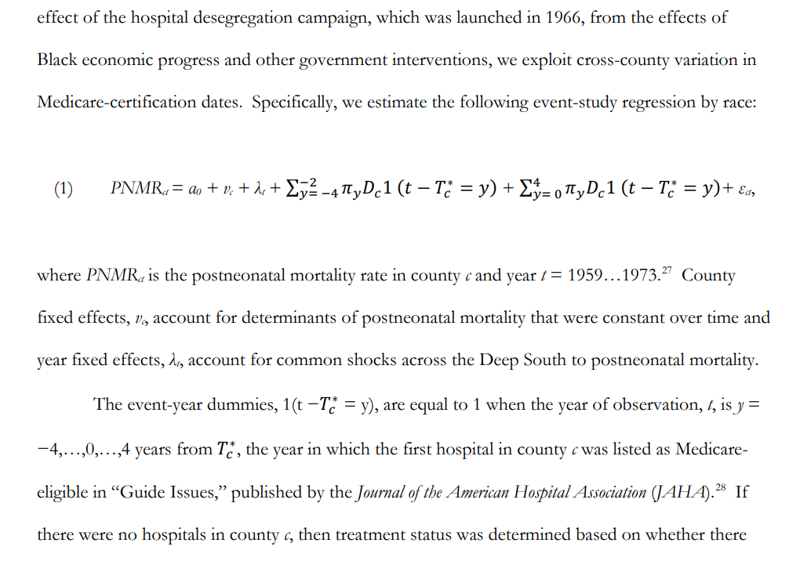
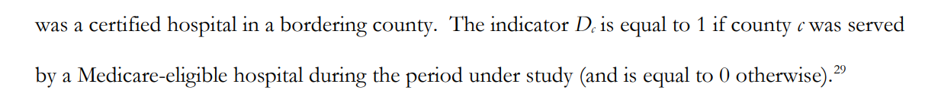
Example of case (i): “Imposing Policy on Reluctant Actors: The Hospital Desegregation Campaign and Black Postneonatal Mortality in the Deep South” by Anderson, Charles and Rees (Forthcoming at Review of Economics and Statistics)
Entire baseline estimation strategy described in less than one page
Easy to refer back to when exploring extensions:
“Including a vector of controls, X_{ct}, on the right-hand side of the estimating equation…”
“In Figure 5, we report event-study estimates based on a modified version of equation (1)…”
Interaction-weighted estimates from Sun and Abraham (2021) are reported later in paper
Because the authors do not lead with this estimator, they do not have to present the (more complicated) equations describing this approach

Slide 6
Example of case (ii): “Changes in Family Structure and Welfare Participation Since the 1960s: The Role of Legal Services” by Cunningham and Goodman-Bacon (Forthcoming at American Economic Journal: Applied Economics)
Starting point:
Estimators proposed by Callaway and Sant’Anna (2020) and Sant’Anna and Zhao (2020)
Avoid entirely having to address theoretical issues associated with TWFE
Tradeoff: Baseline strategies require 4 equations and take over 4 pages to discuss
Up to this point, I’ve preferred the approach by Anderson et al. (forthcoming)
Going forward, I’m going to proceed in the manner of Cunningham and Goodman-Bacon (forthcoming)

Slide 7
Example of case (iii)…and what NOT to do!
Recent unpublished working paper (which I was asked to referee):
Estimate relationship between state sobriety checkpoint laws and traffic fatalities.
The only equation they present is the following TWFE specification:
The authors never present TWFE estimates in their paper
They only show interaction-weighted estimates from Sun and Abraham (2021)
Poor practice and form
Wrong!
Unfortunately, this happens way too often…

Slide 8
Making event-study figures
Two standard approaches
“Connected”
vs.
“Disconnected”
See Scott’s substack on this:
https://causalinf.substack.com/p/data-visualization-and-the-event
-I’m stealing from this in what follows!

Slide 9
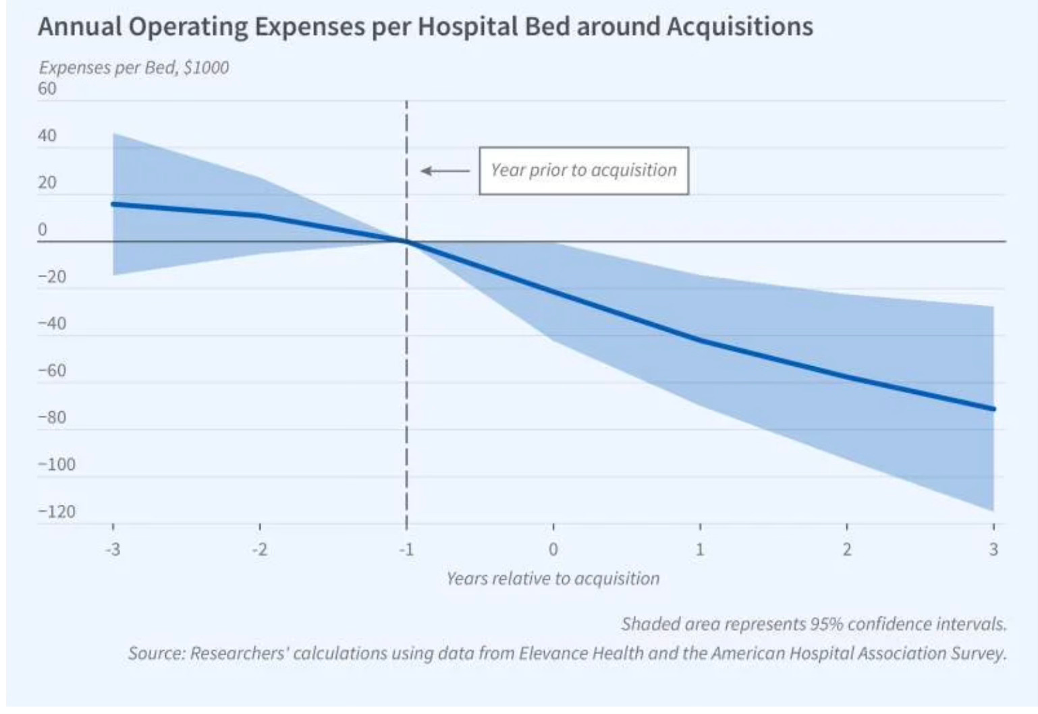
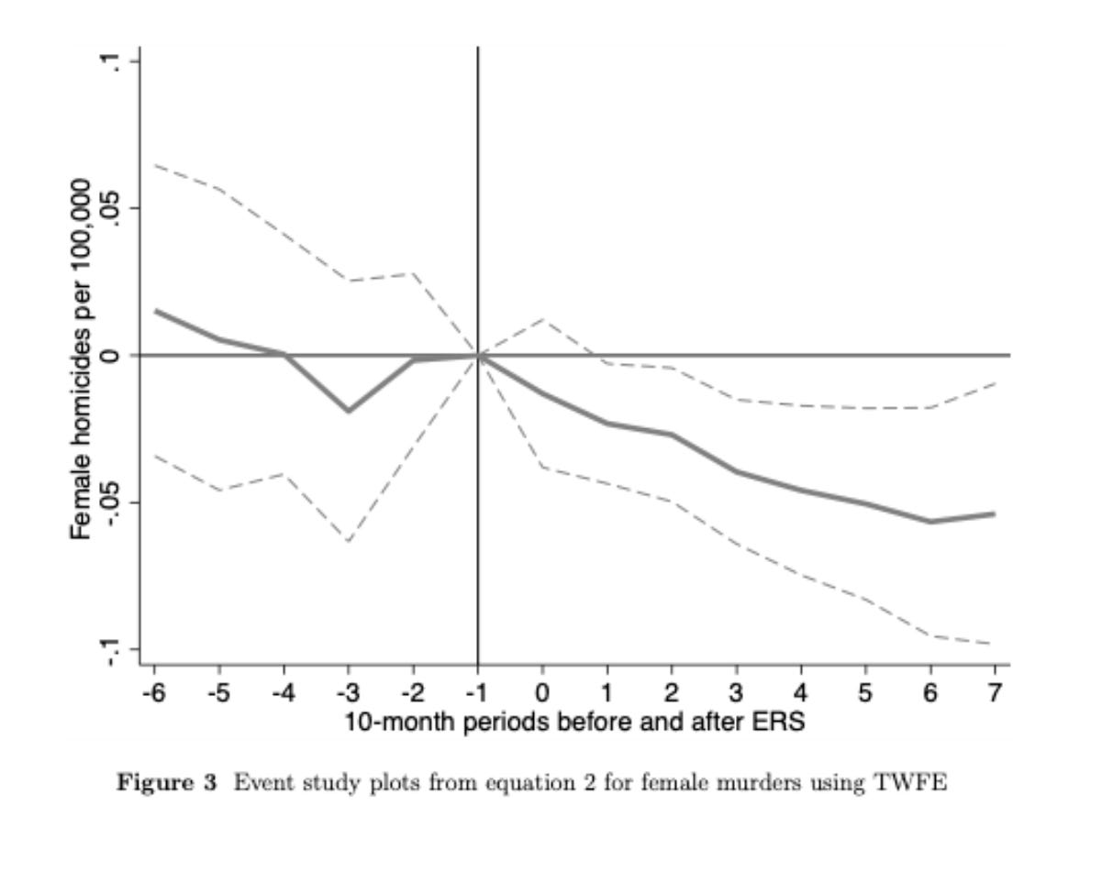
“Connected” (aka bow-tie) event-study figures
Figures taken from Scott’s substack on “Visualizing your event study plot”

Slide 10
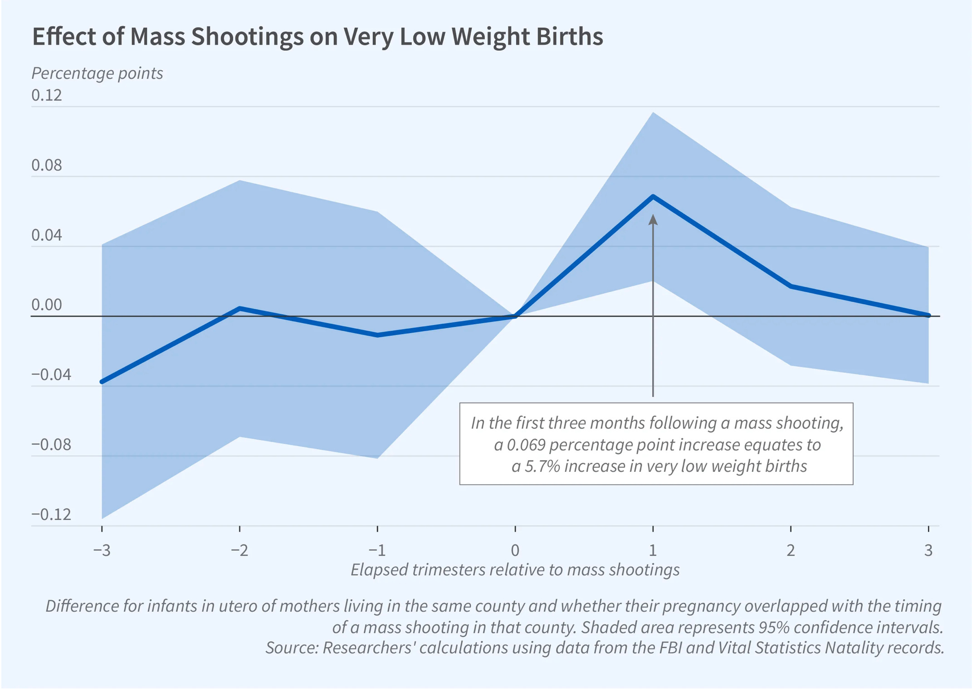
“Connected” (aka bow-tie) event-study figures
I dislike this style of event study
Optical illusion #1: More point estimates than were actually estimated
Optical illusion #2: Tighter confidence intervals around zero
If you asked a layperson about this portion of the figure, what would they say?
They would have no idea that this is just an artifact of connecting dots between estimates at t = -1 and t = 0 (or between t = 0 and t = 1), where the CIs are equal to zero at the omitted category (i.e., at t = 0).
Optical illusion #3: Quick glance at CIs and you can almost fool yourself there are pre-trends
Just not very aesthetically pleasing in general
Figure taken from Scott’s substack on “Visualizing your event study plot”

Slide 11
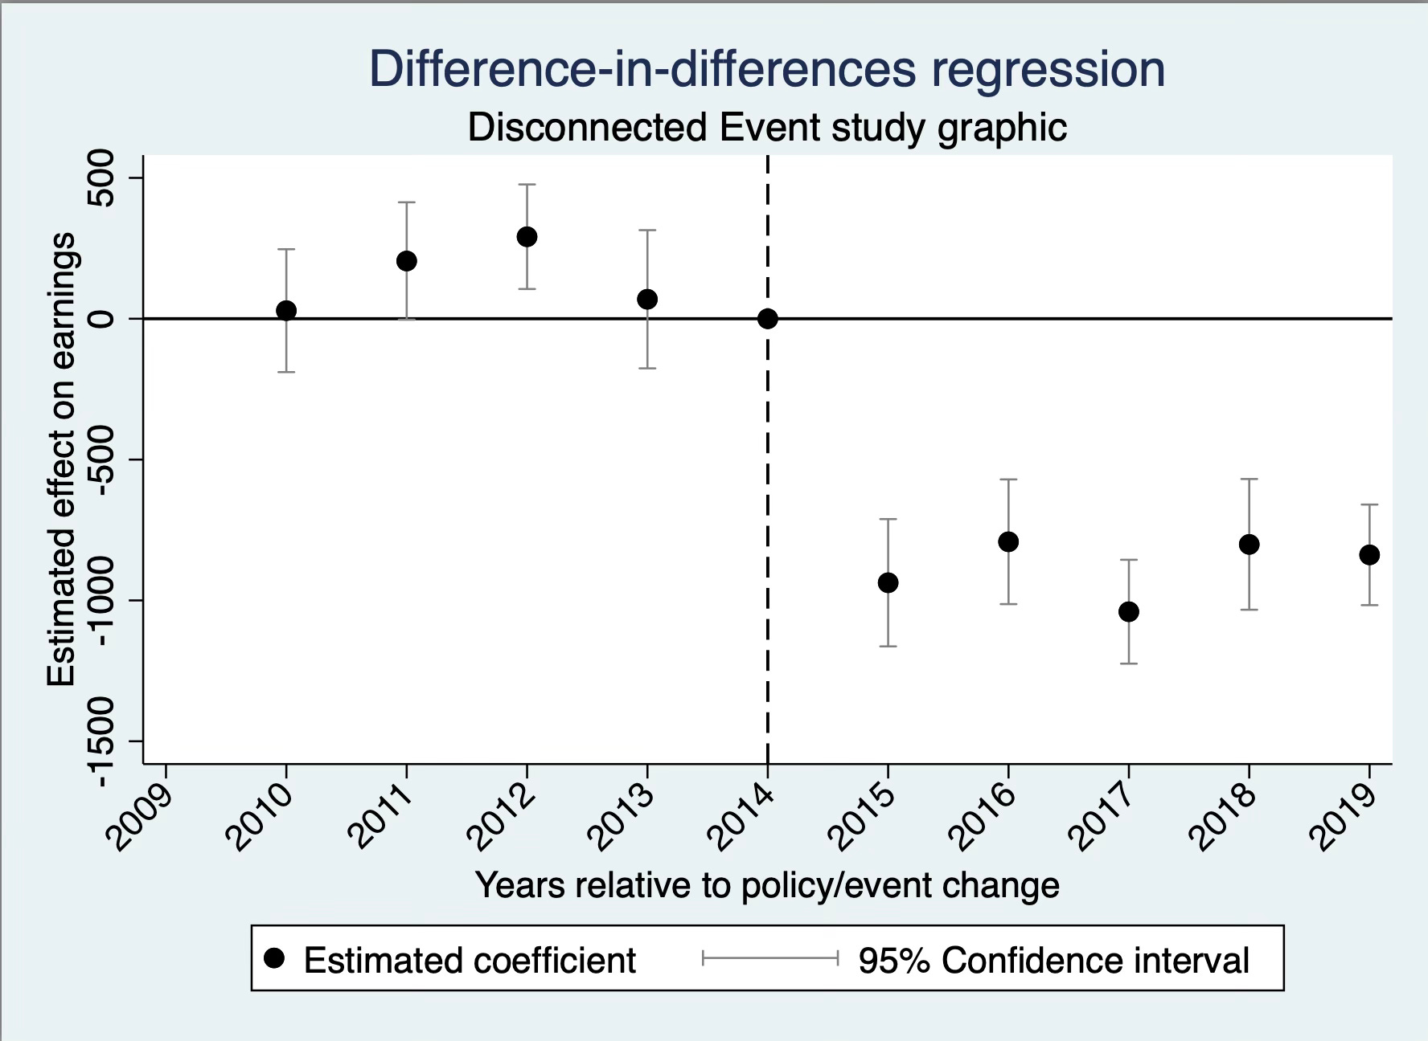
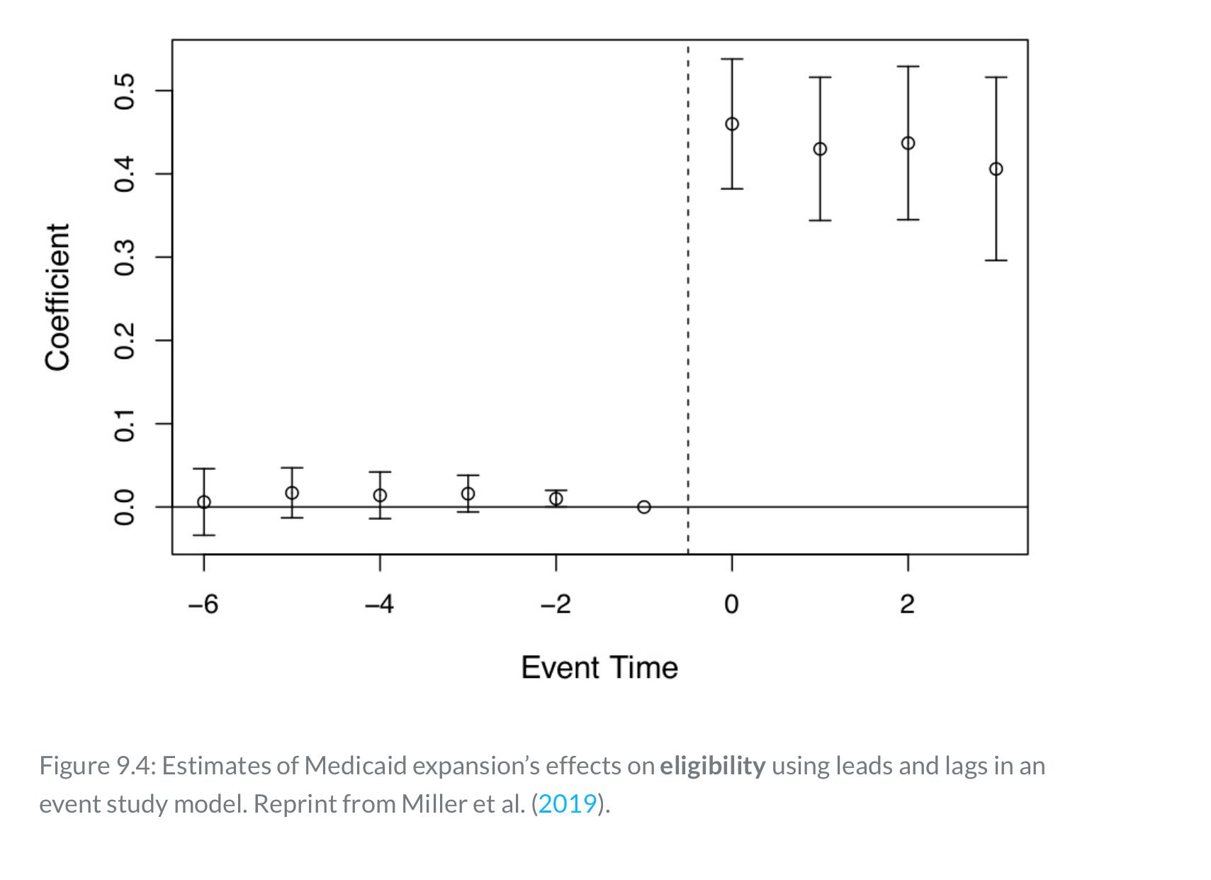
“Disconnected” event-study figures
Figures taken from Scott’s substack on “Visualizing your event study plot”

Slide 12
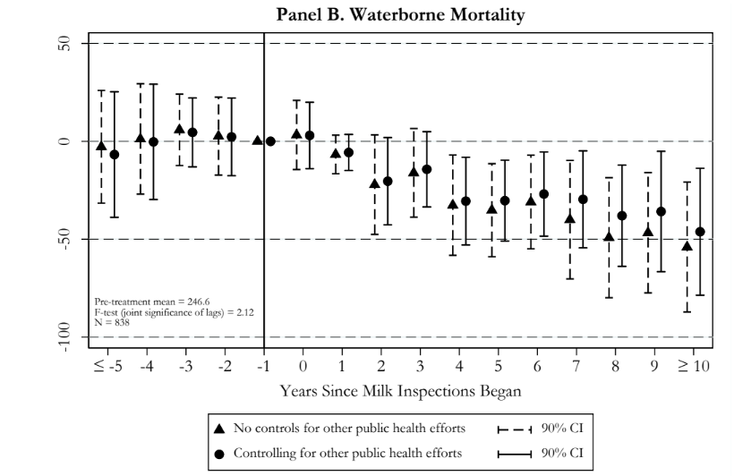
“Disconnected” event-study figures
Does not suffer from the optical illusions present in the bow-tie-style figures
No illusion that point estimates exist across some continuous space
No “pinching” of the CIs on either side of the omitted category
Clean and pretty!
Figure from Anderson et al. (2022, NBER WP No. 30063)

Slide 13
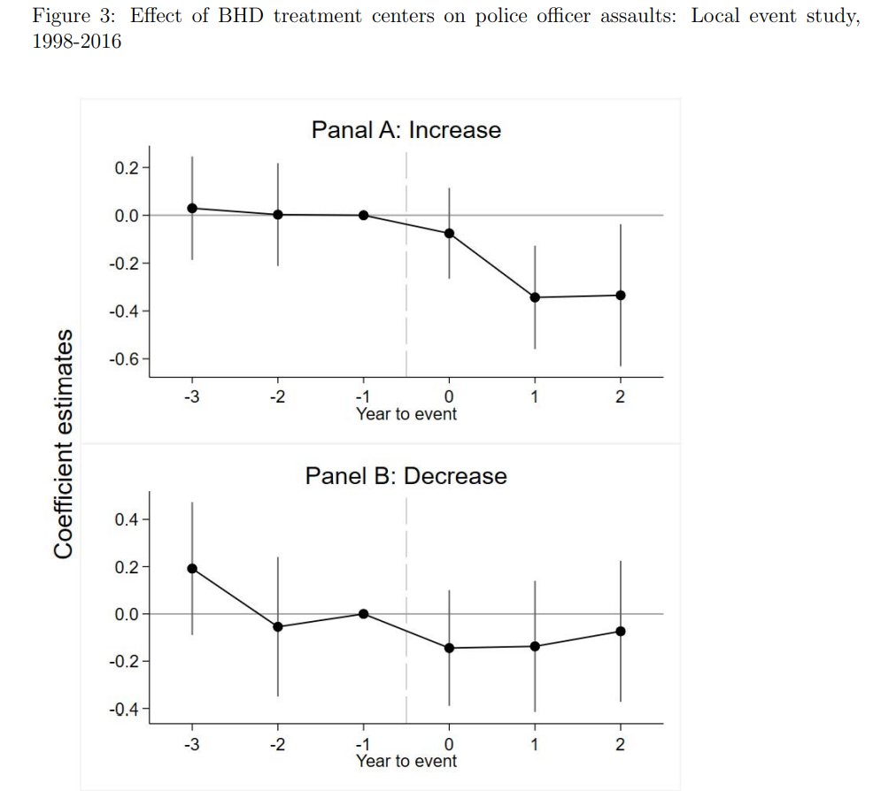
Hybrid approach?
Better than the bow-tie approach
But why connect the dots?
Figure from Deza et al. (2024, NBER WP No. 31391

Slide 14
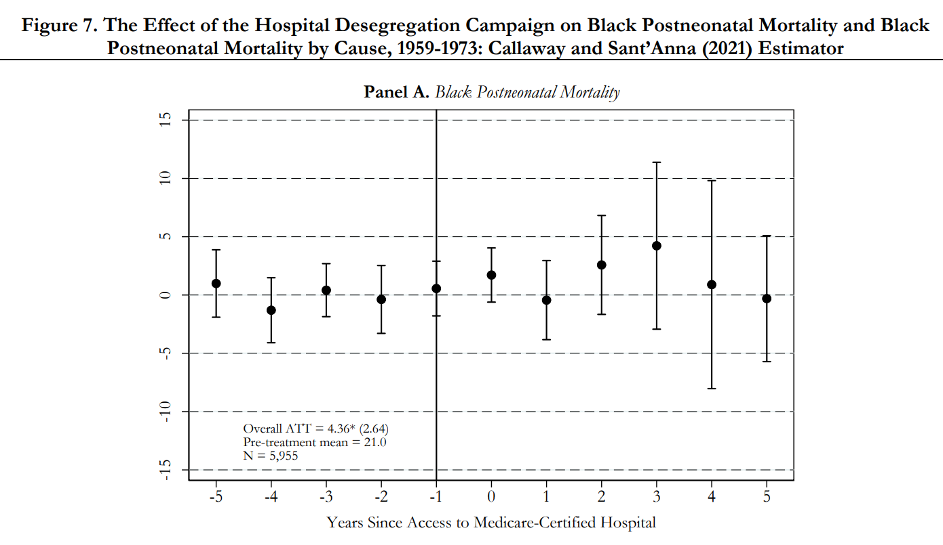
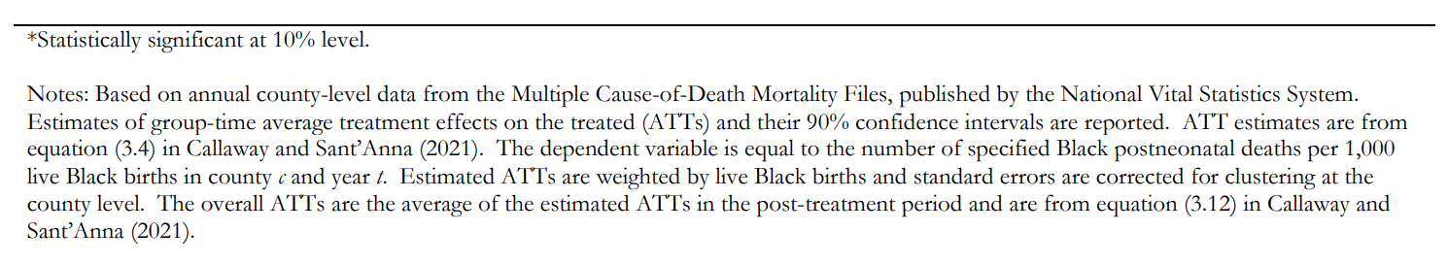
More on event-study figures: Providing important information
Use white space to present additional information
Just like you would with a table, make sure your notes allow the figure to “stand alone”
Do not make your reader wade back through the manuscript to figure out what they are looking at
Figure from Anderson et al. (forthcoming, Review of Economics and Statistics)
Panels B and C of figure omitted for brevity

Slide 15
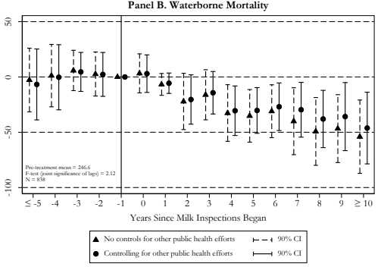
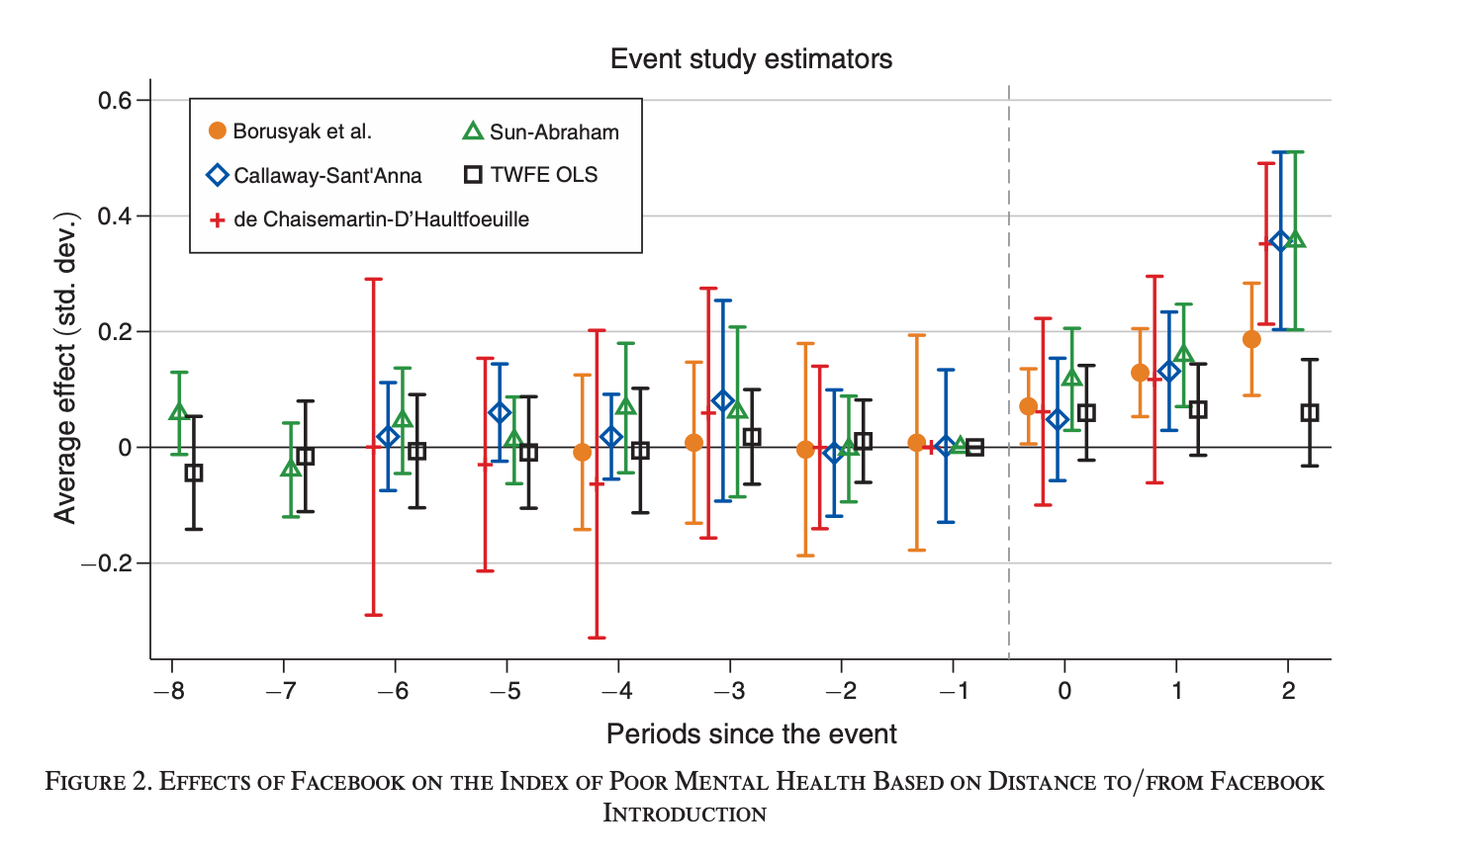
More on event-study figures: Keep it nice and neat
I never present more than two sets of estimates in any one figure
Avoid clutter!
I’m not a fan of this…
Figure from Braghieri et al. (2022, American Economic Review)

Slide 16
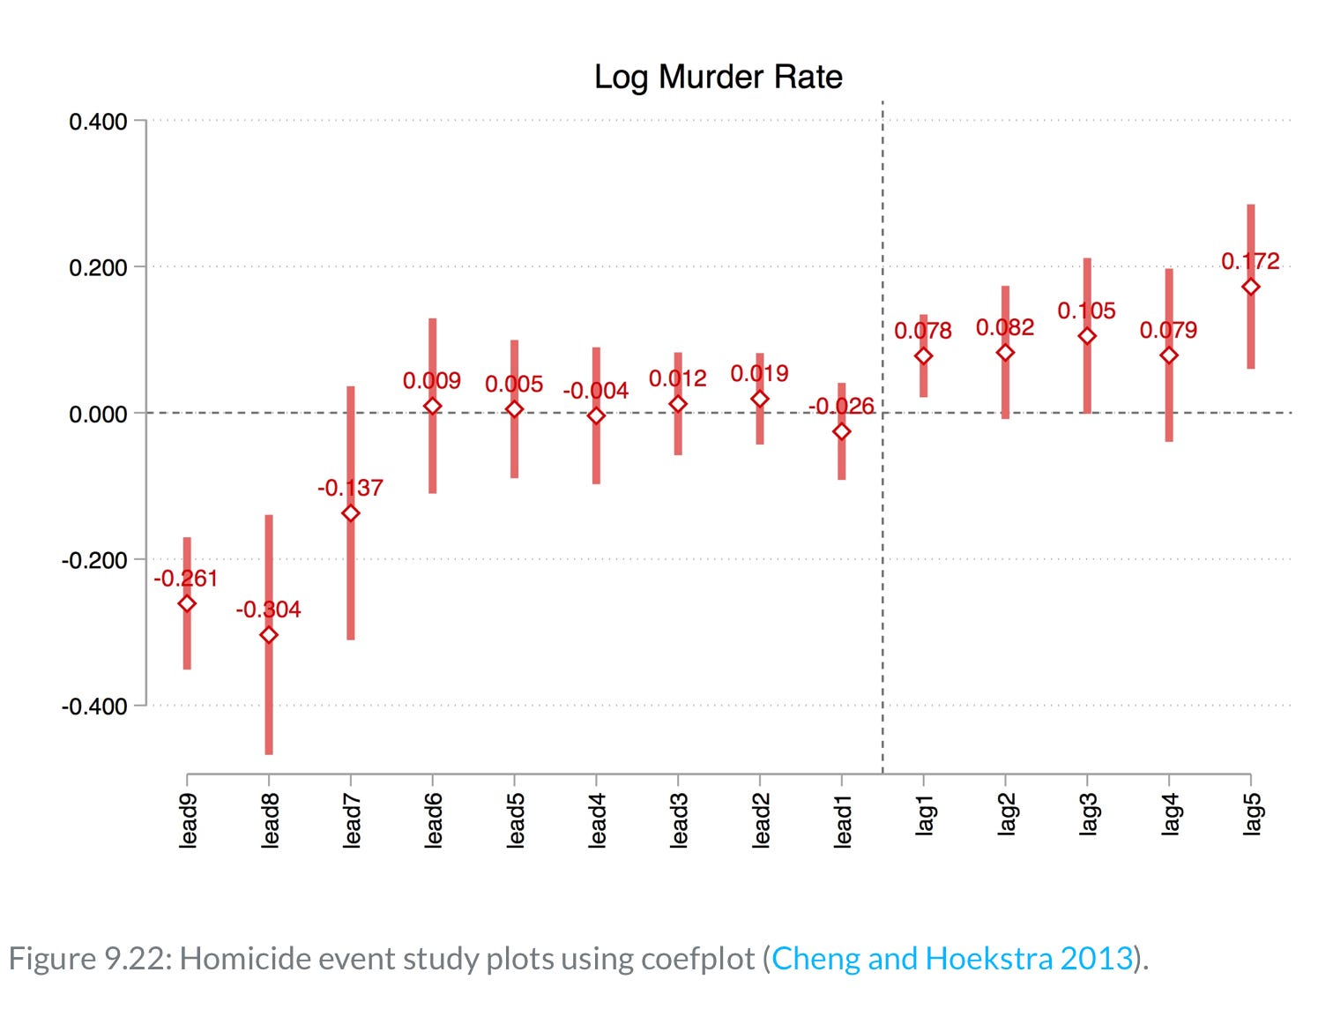
More on event-study figures: Showing values of coefficient estimates
What if I want to report the exact coefficient estimates from my event study?
One option…
I’m not sold on appearance
Figure taken from Scott’s substack on “Visualizing your event study plot”

Slide 17
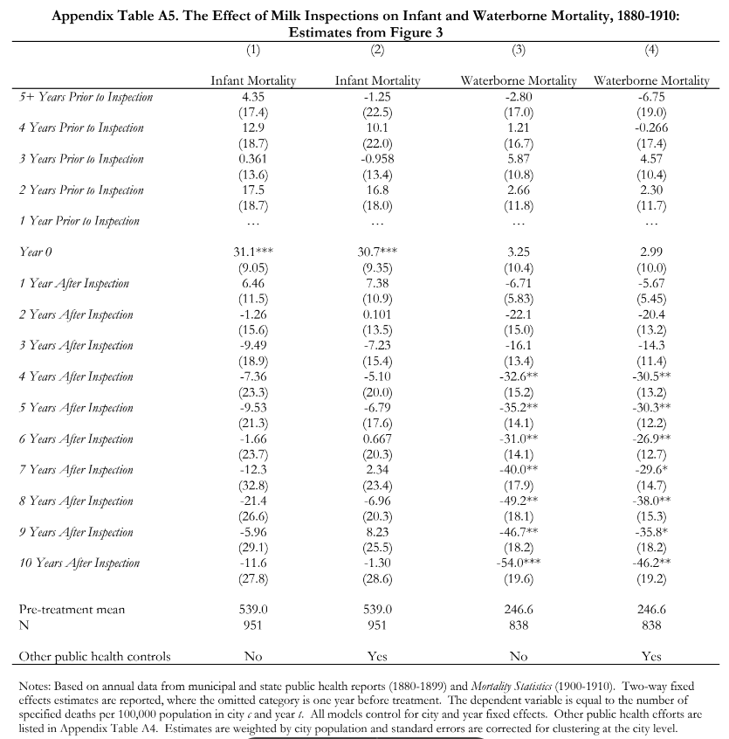
More on event-study figures: Showing values of coefficient estimates
Another option is to include an appendix table
NOT pretty for a presentation
But perfectly fine in your appendix
Allows for presentation of estimates from more than one specification

Slide 18
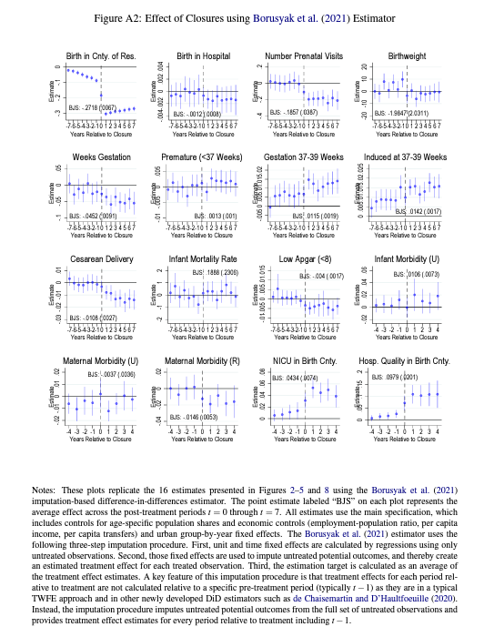
More on event-study figures: Presenting robustness checks
How should I show a bunch of event-study robustness checks?
Error on side of more figures with fewer panels, as opposed to fewer figures with more panels
Here is a place where appendices are your friend!
You do not want a figure that looks like this…

Slide 19
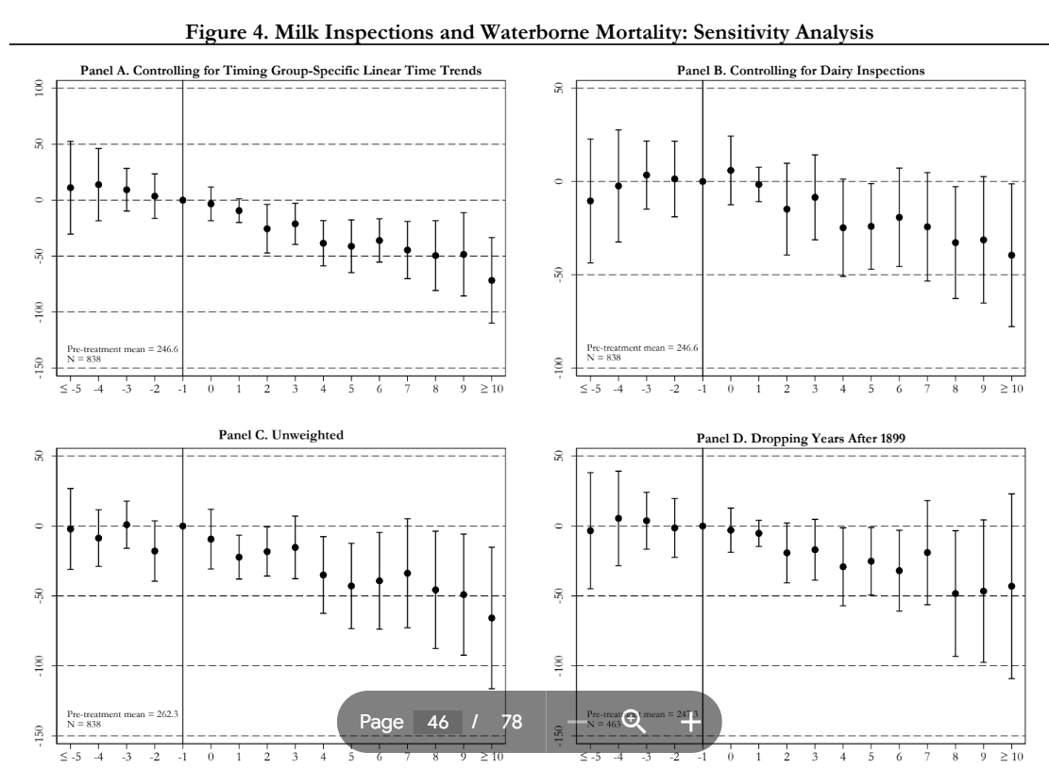
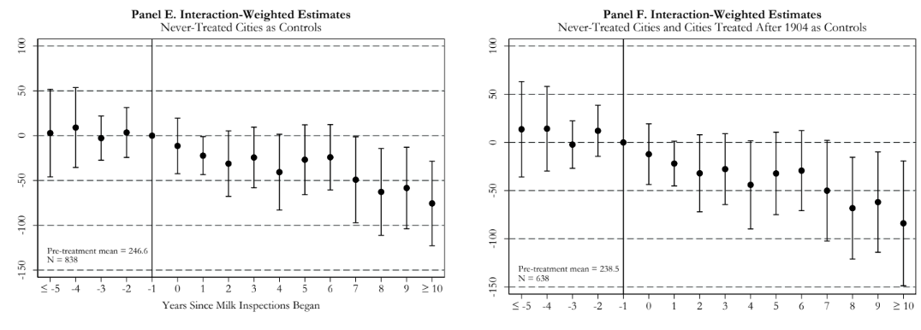
More on event-study figures: Presenting robustness checks
This looks much better! (Not for a presentation but for your paper)
Place less important robustness checks in appendices to avoid clutter
It may not be necessary to present some robustness checks at all…just mention them in a footnote
It is ok for a figure with multiple panels to span more than one page in your document
Do not make reader squint or zoom way in!
Figure from Anderson et al. (2022, NBER WP No. 30063)

Slide 20
Conclusion
Take pride in the appearance of your results
Event-study figures help tell the story of your paper!
Sloppy presentation of results can sink a paper
A referee comment I recently wrote…
The presentation of the results is very sloppy and the authors make careless mistakes throughout their manuscript. If they were this careless in the observed part of their research, how can I trust that they were careful in the unobserved component (i.e., data collection, cleaning, and analysis)?
Think of creating tables and figures as an art form…take the time to do this right

